Slide 1
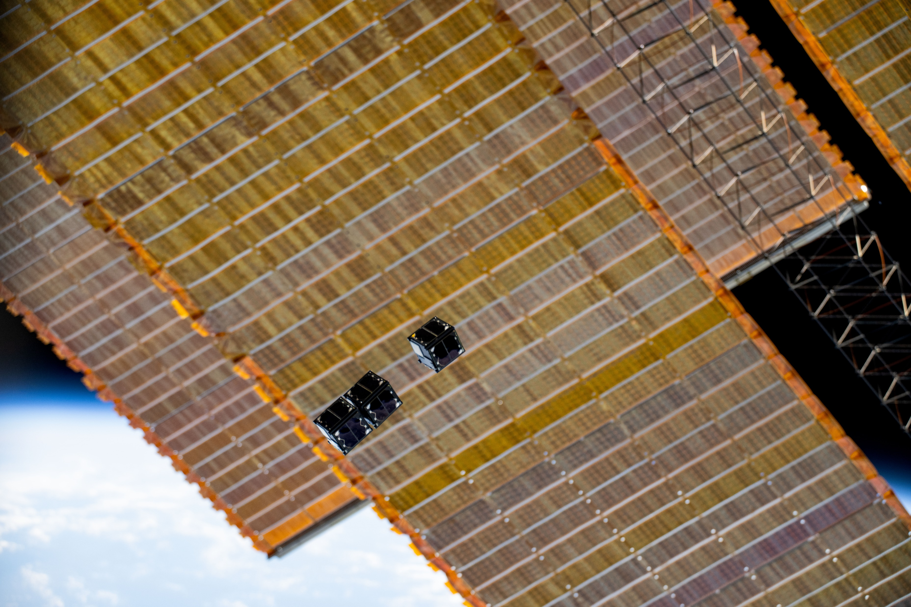

INTRODUCTION TO EMBEDDED PROGRAMMING
Notes:
Hey guys welcome to week 21
We’re going to go through an intro into microcontrollers with the goal of trying to link our already familiar Arduino Nanos from the Bintroduction to electronics
To STM32 microcontrollers
We’ll go through
reading pinout schematics
Understanding the workings of
Digital pins, analog pins and basic communication protocols

Slide 2
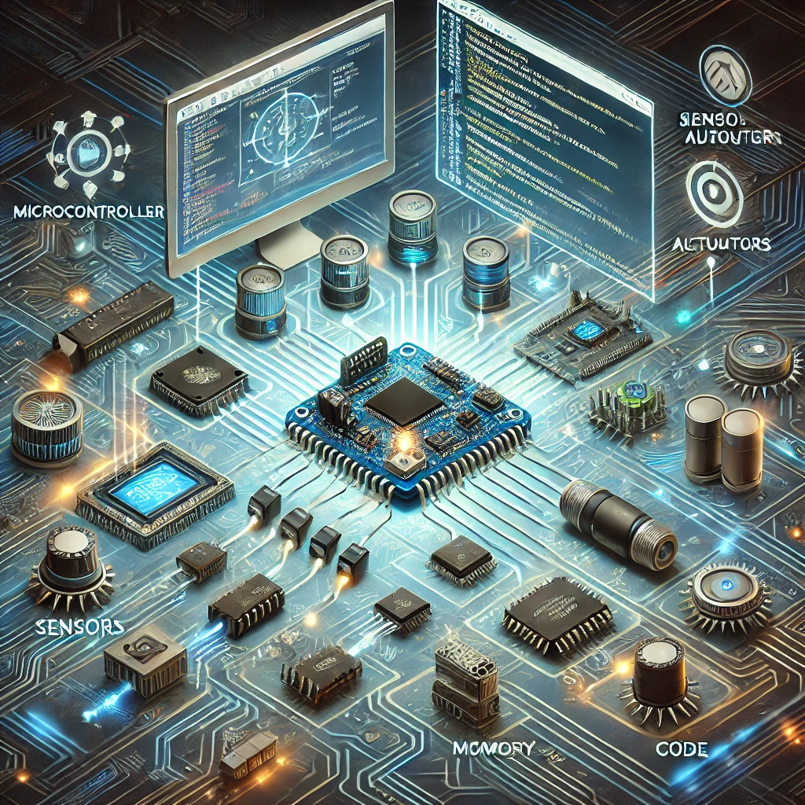
WHAT IS EMBEDDED PROGRAMMING
Programming hardware
Sensors
Actuators
ChatGPT Interpretation on Embedded Programming
Notes:
Embedded programming involves writing software that interacts closely with the hardware components of the system. This software controls tasks like reading sensor data, processing it, and triggering specific actions based on predefined conditions. For example, in a washing machine, the embedded program manages water level sensors, spin motors, and timers.
Since embedded systems often have limited resources like memory and processing power, embedded programming focuses on efficiency, real-time operation, and reliability.

Slide 3
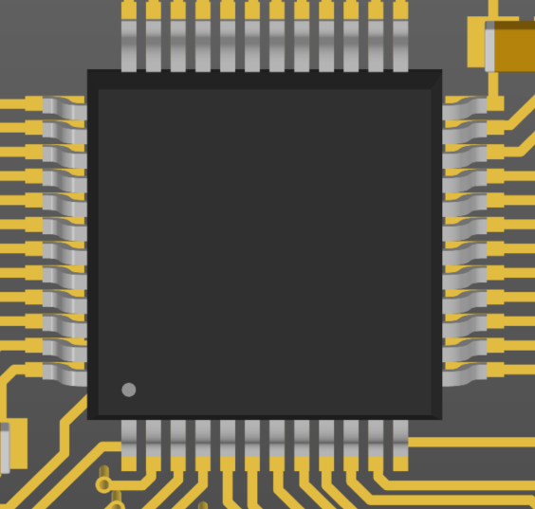
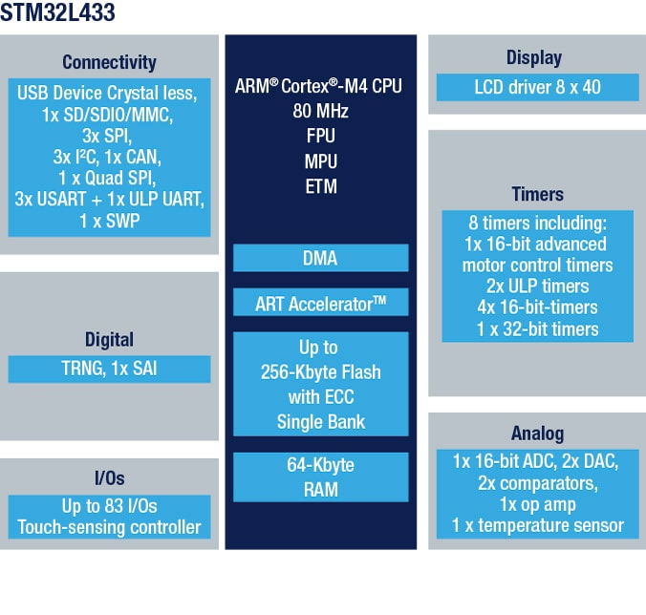
MICROCONTROLLERS
Notes:
A microcontroller is a small computer on a single integrated circuit. A microcontroller contains one or more CPUs along with memory and programmable input/output peripherals.
This is reminiscent to a city where different parts of the microcontroller are responsible for different operations. Also, different cities vary in size, complexity and functionality just as microcontrollers do. Furthermore, each city may use a multitude of languages to communicate information across it's information dense network. The only thing a city doesn't have is a datasheet rich of highly detailed technical information of how these small subsystems interconnect with the outside world.

Slide 4
HOW CAN A MICROCONTROLLER BE FASTER?

Slide 5
HOW TO COMMUNICATE WITH THE OUTSIDE WORLD
Notes:
A microcontroller is a small computer on a single integrated circuit. A microcontroller contains one or more CPUs along with memory and programmable input/output peripherals.
This is reminiscent to a city where different parts of the microcontroller are responsible for different operations. Also, different cities vary in size, complexity and functionality just as microcontrollers do. Furthermore, each city may use a multitude of languages to communicate information across it's information dense network. The only thing a city doesn't have is a datasheet rich of highly detailed technical information of how these small subsystems interconnect with the outside world.

Slide 6
HOW TO COMMUNICATE WITH THE OUTSIDE WORLD
Notes:
A microcontroller is a small computer on a single integrated circuit. A microcontroller contains one or more CPUs along with memory and programmable input/output peripherals.
This is reminiscent to a city where different parts of the microcontroller are responsible for different operations. Also, different cities vary in size, complexity and functionality just as microcontrollers do. Furthermore, each city may use a multitude of languages to communicate information across it's information dense network. The only thing a city doesn't have is a datasheet rich of highly detailed technical information of how these small subsystems interconnect with the outside world.

Slide 7
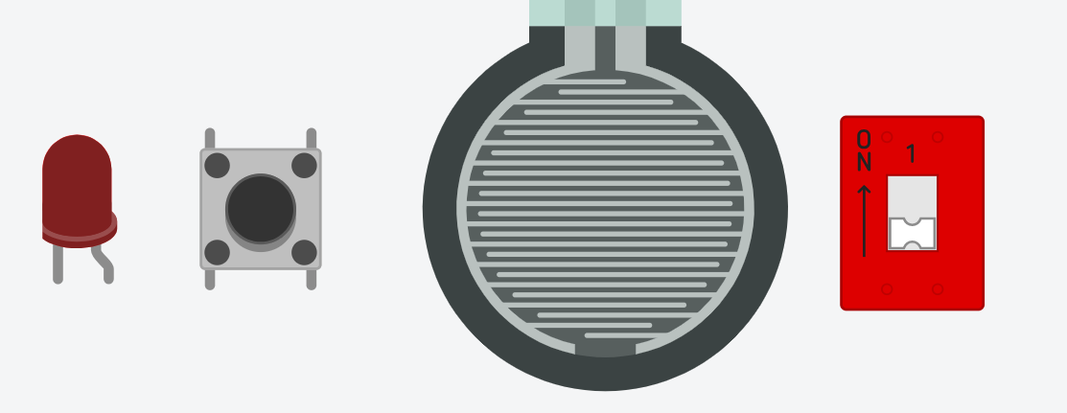

WHAT IS AN DIGITAL PIN?
Digital High
1
0.5VCC
0.3VCC
Digital Low
0
Notes:
Digital Pin
Can be an input or an output
As an INPUT:
Takes a reading from the pin -> depending on the voltage value it either returns a 1 or a 0 based on where the voltage fits within the figure shown above
Vcc is the microcontrollers supply voltage which is 5V for the Arduino NANO
The input is sensitive to current and must be protected by a resistor where appropriate.
As an OUTPUT:
In the microcontrollers code the pin can be set to high or low
Where High is Vcc
And Low is GND
As an output it can only supply a low power signal and shouldn’t be used to power devices directly
Where these are commonly used
Input:
Buttons
Switches
State machine variables -> any time we want the microcontroller to do something after we tell it to and a multitude of different ways.
Output:
Tell another component to activate
Sensors
Another microcontroller
Signal generation
PWM, Clock signals etc.

Slide 8

WHAT IS AN ANALOG PIN?
5V
1024
ADC
BIT VALUE
“Why 1024?”
VOLTAGE
Number of bits
Sensor Voltage
Binary Value
Binary Value:
1001001100
Decimal Value:
588
$$2^{10}$$
0V
0
Each bit can be 1 OR 0
TIME
Notes:
What does an Analog pin do?
It translates continuous analog signals into discrete digital values that microcontrollers can understand and process.
Therefore, it will round down to the nearest bit value that corresponds to the continuous voltage input
These pins convert this by utilising an ADC (Analog to Digital Converter)
What are ADC characteristics?
ADC’s are bounded by two main things
Their maximum voltage (normally bound to supply voltage) 5V in the case of the Arduino Nano
Their resolution which means the number of bits they have.
This number of bits is divided evenly through the maximum voltage

Slide 9
WHAT DOES ADC_IN0 MEAN?
ADC
S0
MULTIPLEXER
S1
S2
TO ARRAY
S3
IN0
IN1
IN2
IN3
IN4
IN5
IN6
IN7
IN8
IN9
IN10
IN11
IN12
IN13
IN14
IN15
Notes:
This is a more indepth look at the multiplexer where if the pins B0, B1 and B2 select which channel you want the ADC to convert.
The B pins are automatically assigned in the code when you try to read an analog pin.

Slide 10
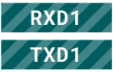
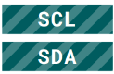
TWO COMMON COMMUNICATION TYPES
UART
RECIEVE
TX
TX
Controller
Peripheral (Sensor)
TRANSMIT
RX
RX
I2C
Peripheral (Sensor)
Peripheral (Sensor)
CLOCK
SCL
Controller
DATA
SDA
Secret Handshakes🤝
Notes:
Here are 2 basic communication styles
I2C and UART.

Slide 11
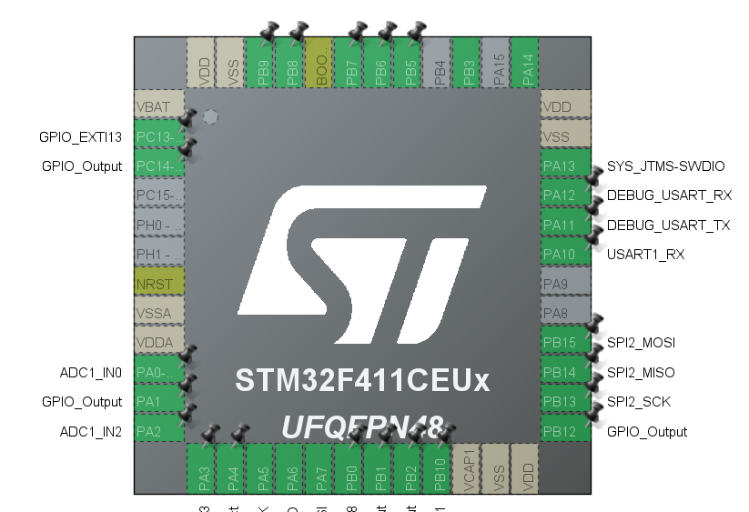
NOW TIE IT BACK TO STM32
Notes:
Here are 2 basic communication styles
I2C and UART.

Slide 12
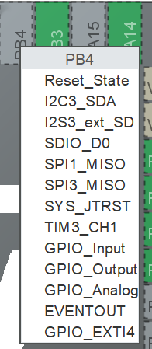
NOW TIE IT BACK TO STM32
Notes:
Here are 2 basic communication styles
I2C and UART.

Slide 13

NEXT WEEK IN
Week 22 – Payload Preliminary Design Development (3 of 4)
Next week we will go over what you'll need to include in your Preliminary Design Review presentation at Curtin on Dec 2nd, 2024
Please send through your progress and questions to binarx@curtin.edu.au so we can support you

